Slide 2


The Initiative for Open Citations
Why is it important to discuss citations now?
Because the Initiative for Open Citations (https://i4oc.org), launched on April 6 last year, has persuaded almost all the major scholarly publishers to open the reference lists they submit to Crossref
Before I4OC, only 1% of these were open
Now, in January 2018, more that 50% of the ~38 million articles with references deposited with Crossref are open
So there are now almost half a billion open journal article references!
Crossref is to be greatly thanked for hosting these references and making them available to the community via its API

Slide 3
Citations are relationships
This meeting has been full of discussion about ENTITY identifiers
DOIs
ORCIDs
OrgIDs
etc.
But I’m here today to talk about a hitherto neglected area
Identifiers for RELATIONSHIPS, specifically CITATIONS

Slide 4

How do we treat relationships?
Relationships are normally treated simply as the links between entities
An alternative richer view is to regard them as data entities in their own right
which permits us to endow the relationships with PROPERTIES
has start date
has duration
has type
has persistent identifier
etc.
relationship
Entity
Entity
has related
Entity
Relationship
has related
Entity

Slide 5
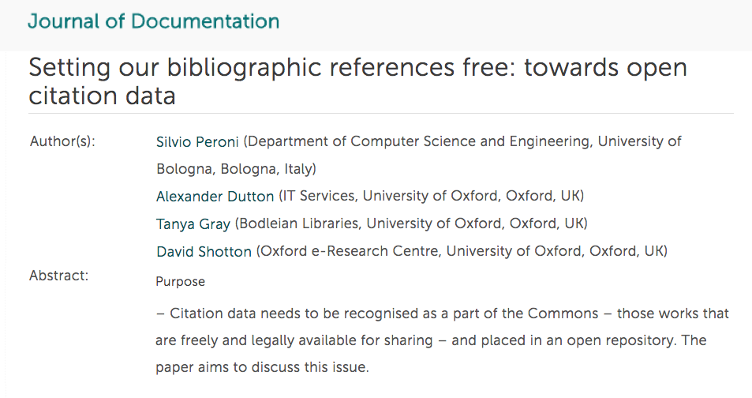
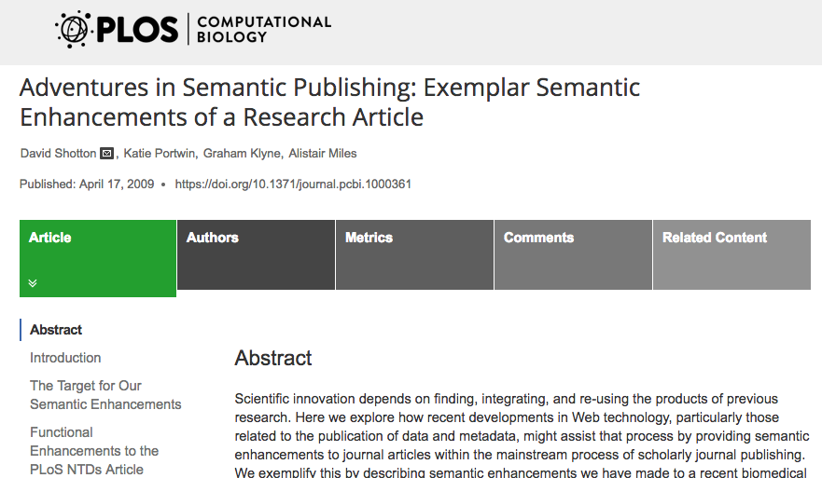
Two views of a citation
A citation as a link
A citation as an entity
has time span: 6 years
has type: Self-citation
is international: Yes
has identifier: oci:7295288-3962641
Citing
article
cites
Cited
article
has citing
article
The Citation
has cited
article

Slide 6
What does it take to turn a citation into a First Class Data Entity?
It must be definable in a machine-readable manner
as a member of the class “Citation” with appropriate object properties
It must be storable, searchable and retrievable
in a well-structured open database designed for bibliographic citations
It must be identifiable
using a global Persistent Identifier Scheme
It must have a Web-based resolution service
that takes the identifier as input and returns a description of the citation
Advantages of treating citations as First Class Data Entity
All the information regarding each citation is available in one place
Citations become easier to describe, distinguish, count and process
If available in aggregate, they are easier to analyze using bibliometric methods
for example to determine how citation time spans vary by discipline

Slide 7
Ontology changes to permit definition of a citation in RDF
This required additions to CiTO, the Citation Typing Ontology:
Class: Citation IRI: http://purl.org/spar/cito/Citation
Subclass: Self citation IRI: http://purl.org/spar/cito/SelfCitation
and
Data property: has citation time span
The temporal characteristic of a citation, namely the date interval (expressed in whole years) between the publication year of the cited entity and the publication year of the citing entity
IRI: http://purl.org/spar/cito/hasCitationTimeSpan
And an addition to the DataCite Ontology
A new member of the class Resource Identifier Scheme
Open Citation Identifier
IRI: http://purl.org/spar/datacite/oci

Slide 8

The OpenCitations Corpus: a database for citations
OpenCitations (http://opencitations.net) is an infrastructure organization directed by myself and Silvio Peroni of the University of Bologna
Its primary purpose is to host and develop the OpenCitations Corpus (OCC), a Linked Open Data repository of bibliographic citation data covering all disciplines
The first OCC prototype was created in Oxford in 2011
A new instance of the OCC, based on our revised OpenCitations Metadata Model, was set up by Silvio at the University of Bologna in early July 2016
It has been ingesting scholarly references continuously ever since then
OpenCitations Corpus
currently holds references from ~302,000 citing bibliographic resources, and
provides ~13 million citation links to over 6.5 million cited resources
These data are freely available in RDF (JSON-LD) under a CC0 public domain waiver

Slide 9
Defining a citation from the OpenCitations Corpus in RDF
A citation in RDF as a link
:citingArticle cito:cites :citedArticle .
A citation in RDF as an entity
<https://w3id.org/oc/virtual/ci/1-18> a cito:Citation ;
cito:hasCitingEntity <https://w3id.org/oc/corpus/br/1> ;
cito:hasCitedEntity <https://w3id.org/oc/corpus/br/18> ;
cito:hasCitationTimeSpan "10"^^xsd:integer ;
datacite:hasIdentifier <https://w3id.org/oc/virtual/id/ci-1-18> ;
prov:wasAttributedTo <https://w3id.org/oc/corpus/prov/pa/7> ;
prov:hadPrimarySource <https://w3id.org/oc/sparql?query=
. . . [three-line query - details on application!] .
Citing
article
cites
Cited
article
has citing
article
The Citation
has cited
article

Slide 10
Open Citation Identifier – the new PID for citations
Today I wish officially to launch the Open Citation Identifier
Abbreviated OCI (and pronounced ‘oh’ ‘see’ ‘eye’), in line with DOI
The scheme is created and operated by OpenCitations (http://opencitations.net) and supports the open citations present in the OpenCitations Corpus (OCC) and other bibliographic databases
Each OCI has a simple structure: oci:number-number
For example, for citations stored in the OpenCitations Corpus, oci:1-18 and oci:2544384-7295288 are both valid OCIs
The first number is the OCC identifier for the citing bibliographic resource
The second is the OCC identifier for the cited bibliographic resource
(These bibliographic resource identifiers are unique within the OCC)

Slide 11
The Open Citation Identifier Resolution Service
The Open Citation Identifier Resolver is running at http://opencitations.net/oci

Slide 12
oci:1-18 resolves to OpenCitations metadata for the citation

Slide 13
Further information about the citing and cited resources
Citing paper
<https://w3id.org/oc/corpus/br/1> a fabio:JournalArticle ;
dcterms:title "ESMO-ESGO-ESTRO Consensus Conference on Endometrial Cancer" ;
fabio:hasSubtitle "Diagnosis, Treatment and Follow-up" ;
fabio:hasPublicationYear "2016"^^xsd:gYear .
etc.
Cited paper
<https://w3id.org/oc/corpus/br/11> a fabio:JournalArticle ;
dcterms:title "ACOG Practice Bulletin #65: Management of Endometrial Cancer" ;
fabio:hasPublicationYear "2005"^^xsd:gYear .
etc.

Slide 14
The Resolver also works with external data suppliers
OCC bibliographic resource identifiers may contain a supplier prefix
a short numerical string delimited by zeros that indicates the supplier of the metadata for that bibliographic resource and its references
For example 010 indicates that Wikidata is the supplier
Thus oci:01027931310-01022252312 is the OCI for a citation between two bibliographic resources whose metadata are recorded in Wikidata
http://www.wikidata.org/entity/Q27931310, the citing resource
http://www.wikidata.org/entity/Q22252312, the cited resource
Using such an OCI in the Open Citation Identifier Resolver pulls live data from the Wikidata SPARQL endpoint and returns information about that citation

Slide 15
A Wikidata citation retrieved using an Open Citation Identifier
Resolution of oci:01027931310-01022252312

Slide 16
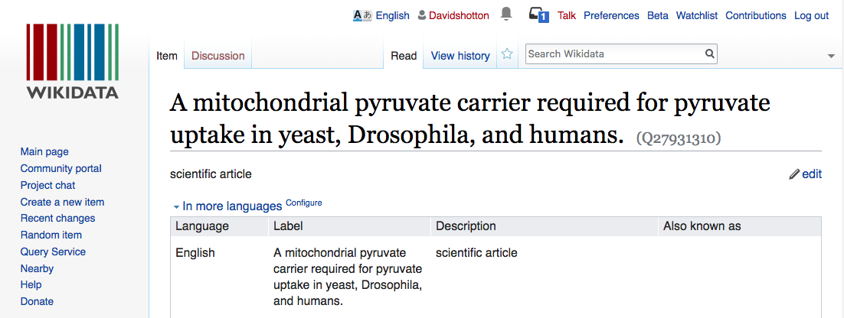
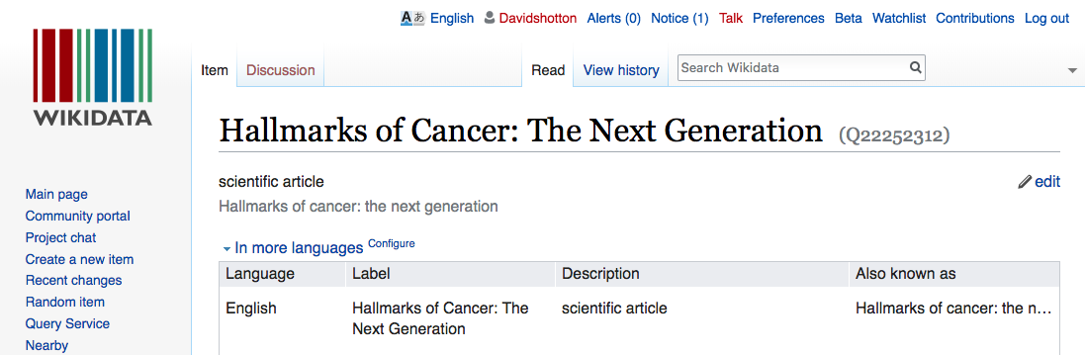
. . . . linking to the Wikidata papers
Citing paper
Cited paper

Slide 17
The resolver could also retrieve DOI data from REST APIs
The Open Citation Identifier Resolver currently works for bibliographic resources both within the OpenCitations Corpus and within external bibliographic databases, provided that:
the service uses a SPARQL endpoint to makes available information about bibliographic resources and the references they contain; and
the service uses numerical identifiers from which to construct the OCI
Although we have yet to implement it, it would be possible to extend this resolution service to work with references supplied via a REST API, and with bibliographic entities that are identified by DOIs
First normalize each DOI to lower case letters
then convert it reversibly to a numerical string using a simple two-numeral lookup table for numerals, lower case letters and other characters
For example, “1” becomes “01”, “2” becomes “02”, “a” becomes “10”, “b” becomes “11” and “/” becomes “36”
See https://github.com/opencitations/oci/blob/master/lookup.csv
We can then use these numerical representations of DOIs to create OCIs

Slide 18
An OCI for a Crossref reference
Thus, for the citation link in Crossref between two papers identifies by the fictitious DOIs
doi:10.1234/a765 and doi:10.3456/b78
The OCI would be
oci:020010203043610070605-0200304050636110708
where 020 is the supplier prefix that we have already reserved for Crossref, and the green numbers are the reversible lookup table numerical equivalents of the characters in each of the DOIs, with the initial “doi:10/” omitted
In this way, OCIs can be assigned to all half-billion Crossref open references
Our OCI resolution service could then resolve this OCI to pull metadata for this citation and its citing and cited resources live from the Crossref REST API

Slide 19


Acknowledgements
Silvio Peroni
Co-Director of the OpenCitations Corpus
The Alfred P. Sloan Foundation
which is funding our work

Slide 20

Thank you!
David Shotton
david.shotton@opencitations.net
Website: http://opencitations.net
Email: contact@opencitations.net
Twitter: @opencitations
Blog: https://opencitations.wordpress.com

